Slide 1

COLLEGE OF NATURAL AND COMPUTATIONAL SCIENCE DEPARTMENT OF COMPUTER SCIENCE
FOOD DELIVERY ANDROID APPLICATION CoSc4411_: FINAL PROJECT

Slide 2
Outline
CHAPTER THREE - SYSTEM DESIGN
Introduction
Software Architecture
Subsystem Decomposition
Hardware/software mapping
Persistent data management
Object diagram
Access control and security
Packages diagram

Slide 3
CHAPTER THREE - SYSTEM DESIGN Introduction
Focus on the overview of the application from the functional view point.
Defining the object model and package diagram
Qualities of the Application
Optimization from nonfunctional requirements
Major quality perspectives used to identify design goals

Slide 4
Design Performance:
Key features to include:
Intuitive interface for finding and ordering food.
Secure payment options.
Accurate restaurant and food item information.
Customer support service available
Accurate order tracking and push notifications

Slide 5
SOFTWARE ARCHITECTURE d User Criteria
User Interface: graphical interface for app interaction (search bar, list of restaurants, map view)
Database: stores all app data (user, restaurant, order info), using firebase real-time database.
Backend Server: handles UI requests and communicates with database
Payment Gateway: handles app payments
Delivery Service: handles food order logistics

Slide 6
Su Subsystem Decomposition stem Decomposition
It is breaking down a software system into smaller,
more manageable subsystems.
Food Delivery Android Application has the following subsystems:
User Management Subsystem: manage guest order application may allow users to place orders as a guest
Order Management Subsystem: creating, modifying, and canceling orders
Payment management Subsystem: processing payments securely and efficiently.

Slide 7
Cont..
Delivery Subsystem:
Notification Subsystem
Report generating subsystem: generating reports various aspects of the application, such as user activity, order volume, and payment processing

Slide 8
Hardware/Software Mapping
Hardware:
Android Devices with GPS and internet connectivity
Server: owned by the application or rented from a cloud provider.
Payment Gateway: in our case PayPal

Slide 9
Cont…
Software:
Android Studio
Android App
Google Maps API for location-based services
Payment gateway API for online transactions
Database management system : store and manage data related to order
Backend server

Slide 10
Cont…
Android Device --> Android OS --> Food Delivery App
Server --> Linux OS --> Apache Web Server --> Firebase Realtime Database --> Payment Gateway
API Restaurant POS --> Windows OS --> Restaurant Management Software

Slide 11
Why Firebase database
Firebase database: NoSQL document-oriented and cloud hosted database that stores data as collections of documents in JSON format
Advantages of using Firebase:
Offline Support
Real-time Data Synchronization
highly scalable(handle millions of concurrent users ): high-traffic applications.
Flexible Data Modeling
Real-time Analytics: analyze the performance of their application in real-time

Slide 12
Object model
Data management object models for a food delivery Android application:
Customer object model
Order object model
Menu item object model
Restaurant object model
Payment object model

Slide 13
Cont…
Object models help organize data and ensure efficiency, reliability, and user-friendliness.

Slide 14
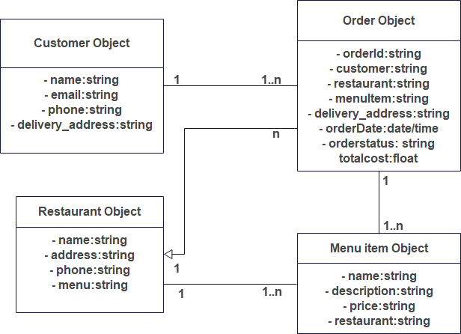
Cont…

Slide 15
Access control and security
To ensure that only authorized users can access the application
some common security measures that can be implemented include
Secure authentication:
Authorization:
Data encryption:
Secure payment processing:.

Slide 16
Package diagram
A package diagram is a type of UML diagram that shows the organization of classes, interfaces, and other elements within a software system
It can be used as a blueprint for the implementation of the system.

Slide 17
Cont…
In a food delivery Android application, the following packages can be included in the package diagram:
User Interface Package:
Business Logic: such as the models, controllers, and services.
Data Access: such as the repositories, database helper and API clients.

Slide 18
Cont…
Location Package:.
Payment Package
Order Package:.
Notification Package:
Backend Package:

Slide 19
Dependency of the packages
These packages can have dependencies on each other, such as
the Order Package depending on the User Interface Package for displaying the menu, ordering process
and on the Database Package for storing and retrieving order information.

